Slide 1

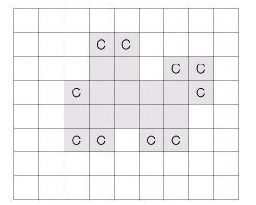
Cheese
The square of N×M (5≤N, M≤100)has a very thin cheese on top as shown in Figure 1. However, N is the number of vertical grids and M is the number of horizontal grids. The cheese should be kept frozen, but when served at room temperature, it comes in contact with air and dissolves slowly.
However, in such a square-shaped cheese, at least two of the four sides of each cheese grid (a small square) contact with indoor temperature air is melted away exactly in an hour. Therefore, if the cheese is the same as the shape of <Figure 1> below (part shown in gray), all cheese grids marked C disappear after one hour.
<Figure 1>

Slide 2
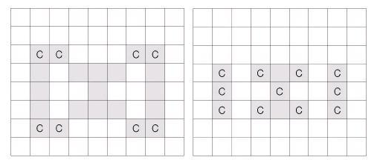
Cheese
The space inside the cheese, as shown in Figure 2, is assumed not to come into contact with the outside air of the cheese. Therefore, the cheese grid that comes into contact with this space does not melt and only the cheese grid marked C disappears. However, one hour later, when the outer air enters the space, the cheese grid marked C disappears as shown in Figure 3.
It is assumed that no cheese is placed on the edge of the grid. Write a program to find the exact time it takes for all the cheese given by input to melt away.
<Figure 2>
<Figure 3>

Slide 3
Cheese
Input
The first line gives two integers N, M (5≤N, M≤100) that indicate the size of the grid. In the next N lines, the part with cheese on top of the grid is marked 1 and the part without cheese is marked zero. Also, each 0 and 1 is separated by a single space.
Output
With the output, the exact amount of time it takes to melt all of the cheese is printed on the first line with an integer.
Input Output
8 9 4
0 0 0 0 0 0 0 0 0
0 0 0 1 1 0 0 0 0
0 0 0 1 1 0 1 1 0
0 0 1 1 1 1 1 1 0
0 0 1 1 1 1 1 0 0
0 0 1 1 0 1 1 0 0
0 0 0 0 0 0 0 0 0
0 0 0 0 0 0 0 0 0

Slide 4
CHEESE
1 hour after
0 | 0 | 0 | 0
0 | 1 | 1 | 1
0 | 1 | 0 | 1
0 | 1 | 0 | 0
0 | 0 | 0 | 0
0 | 1 | 1 | 1
0 | 1 | 0 | 1
0 | 1 | 0 | 0
-1
-1
-1
-1
-1
3
2
2
2
-1
2
-1
2

Slide 5
1 hour after
-1 | -1 | -1 | -1
-1 | 3 | 2 | 2
-1 | 2 | 0 | 1
-1 | 2 | 0 | 0
0
0
0
0
0
0
1
1
0
1
0
1
Def IsDone():
cnt = 0
for y in range(n):
for x in range(2):
if CHEESE[y][x] == -1 or CHEESE[y][x] > 2: CHEESE[y][x] = 0;
elif CHEESE[y][x] == 2 or CHEESE[y][x] == 1
CHEESE[y][x] = 1; cnt+=1
return cnt == 0

Slide 6
1 hour after
2 hour after
0 | 0 | 0 | 0
0 | 0 | 1 | 1
0 | 1 | 0 | 1
0 | 1 | 0 | 0
0 | 0 | 0 | 0
0 | 0 | 1 | 1
0 | 1 | 0 | 1
0 | 1 | 0 | 0
-1
-1
-1
-1
3
-1
-1
2
2
2
-1
3
-1
2

Slide 7
After 2 hours
After 3 hours
-1 | -1 | -1 | -1
-1 | -1 | 3 | 2
-1 | 3 | 0 | 1
-1 | 2 | 0 | 0
0 | 0 | 0 | 0
0 | 0 | 0 | 1
0 | 0 | 0 | 1
0 | 1 | 0 | 0
0
0
0
0
-1
-1
-1
-1
0
-1
3
0
0
0
1
-1
-1
2
0
2
0
-1
-1
-1
3
-1
3
-1
-1
0
1
2
The number of ‘1’ cnt = 3
return cnt==0;

Slide 8
After 3 hours
-1 | -1 | -1 | -1
-1 | -1 | -1 | 3
-1 | -1 | -1 | 3
-1 | 3 | -1 | -1
0
0
0
0
The number of ‘1’ cnt = 0
0
0
0
0
return cnt==0
0
0
0
0
0
0
0
0
Hour =0
While not IsDone():
GetSome(0, 0)
Hour++
print("%d" %hour)

